Slide 1
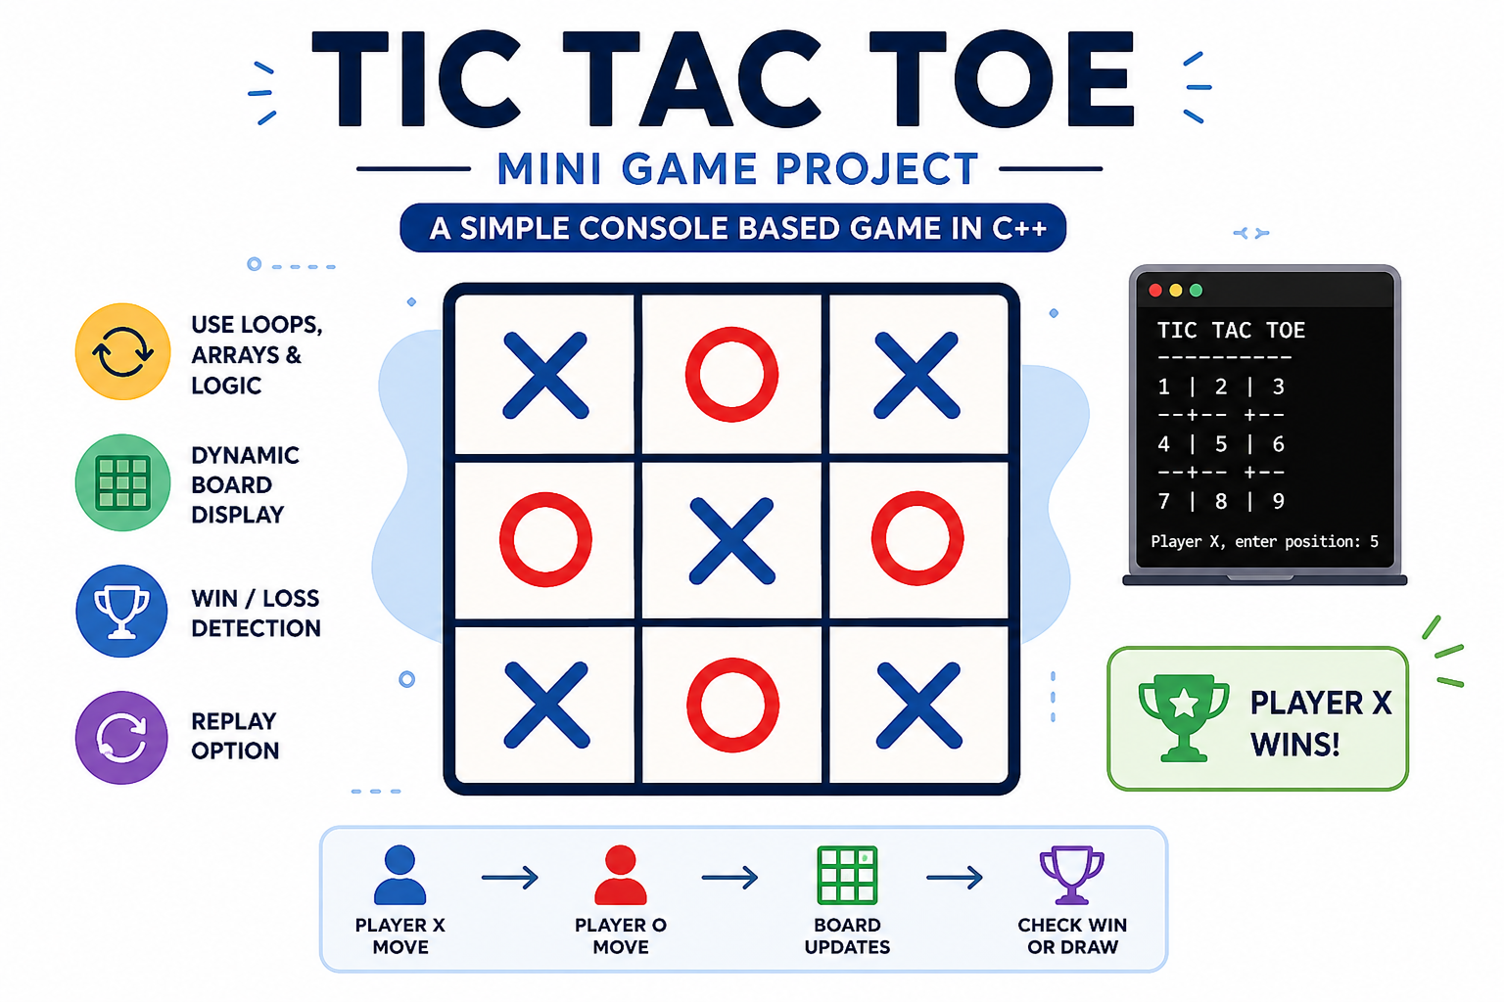
Project :

Slide 2
Aim:
To develop a console-based Tic Tac Toe / Snake Game in C++ that demonstrates core programming concepts such as loops, arrays, functions, and conditional statements, while providing an interactive gaming experience with dynamic board display, win/loss detection, and replay functionality.

Slide 3
Key Features:
Console-Based Gameplay – Runs in the command-line interface using C++.
Dynamic Game Board Display – Updates and displays the game board after every move.
User Input Handling – Accepts and validates player inputs.
Loops and Conditional Logic – Uses loops and decision-making statements to control game flow.
Arrays for Data Storage – Stores and manages game board data using arrays.
Win/Loss Detection – Automatically checks for winning or losing conditions.
Draw Detection – Identifies when the game ends in a tie.
Replay Option – Allows players to restart and play the game again.
Interactive User Experience – Provides clear instructions and feedback during gameplay.

Slide 4
Scope of the Project (Tic-Tac-Toe Game):
This project provides a simple and interactive Tic-Tac-Toe game for two players. It helps users improve logical thinking and decision-making skills while demonstrating programming concepts such as arrays, loops, functions, and conditional statements. The project can be further enhanced by adding a computer opponent, score tracking, and a graphical user interface.

Slide 5
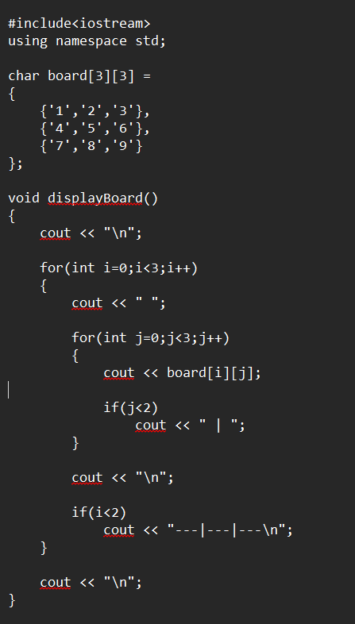

Slide 6
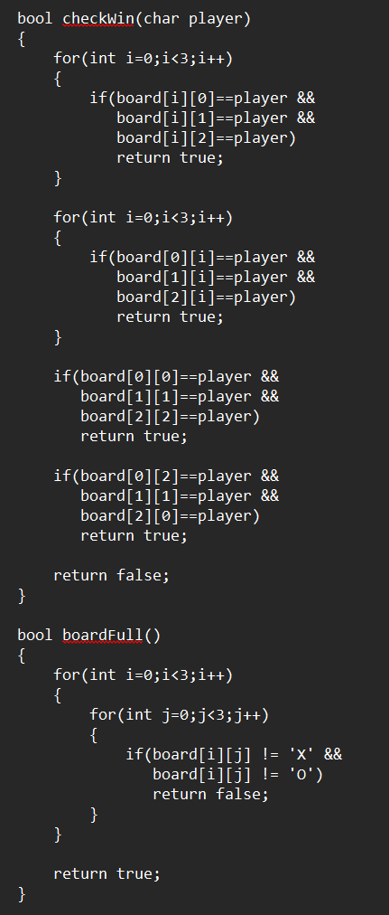

Slide 7
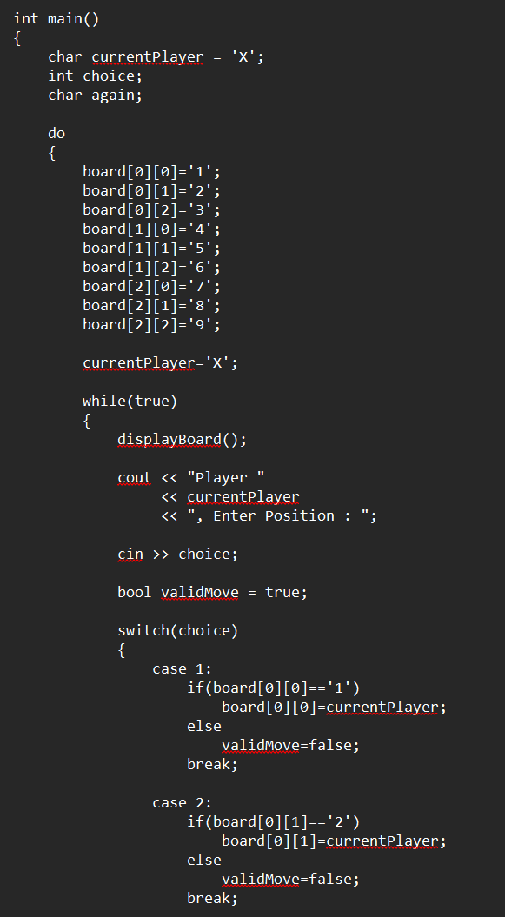

Slide 8
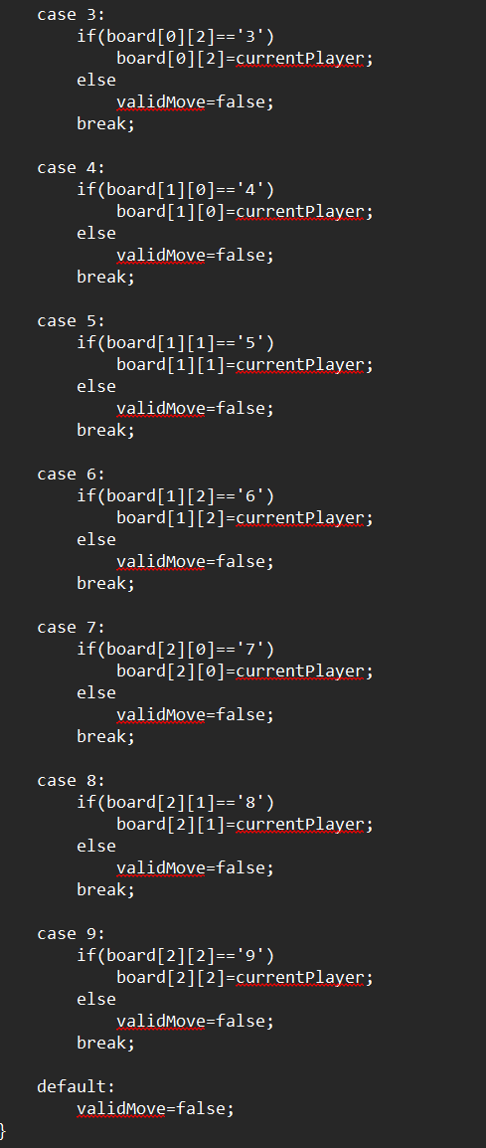

Slide 9
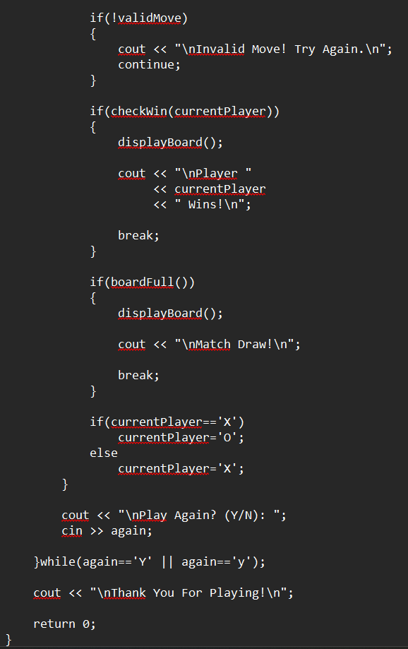

Slide 10
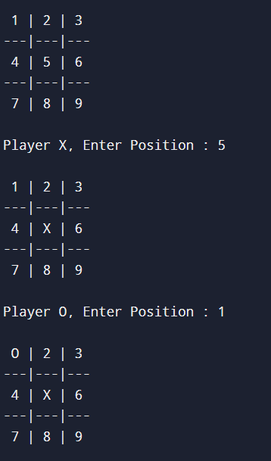
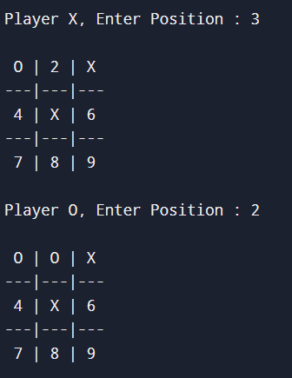
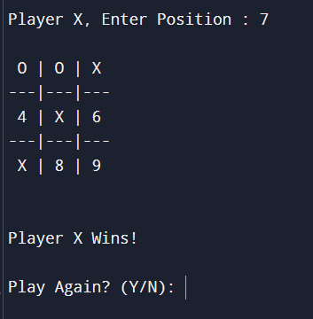
Output:

Slide 11
Conclusion:
The Tic Tac Toe Game was successfully developed using C++. The project demonstrates the use of arrays, loops, and conditional statements for implementing game logic. The game dynamically updates the board after each move, detects winning conditions, and provides a replay option. It serves as a simple and interactive application for understanding basic programming concepts.

